Slide 1
UNITED STATES CHANGE IN GDP BY YEAR
John Wensink • 9/20/20

Slide 2
Overview
United States Change in GDP by Year
The Federal Reserve Bank of St. Louis (2020) publishes information about the United State’s percentage change in Gross Domestic Product (GDP) monthly on its public website. We will examine the hypothesis that ‘American GDP is experiencing a an abnormal change’, by attempting to refute the null hypothesis ‘American GDP is not undergoing abnormal change.’

Slide 3
SUMMARY STATISTICS
FED DATA FROM 4/1/2020
Data was pulled from the FED’s (2020) website, SAS/SUE Summary Statistics helps us to understand measures of center and spread.
The usual statistics of mean, standard deviation, min, max, and N were select along side custom parameters such as mode, range and skewness.
This data differs substantially with the stale data from the MIS445 homepage, underscoring the importance of using up-to-date data.
The two sets of summary statistics are displayed together to highlight the impact of recent outliers in GDP change.

Slide 4
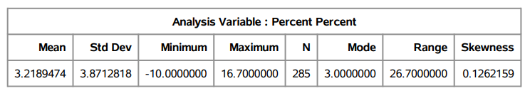
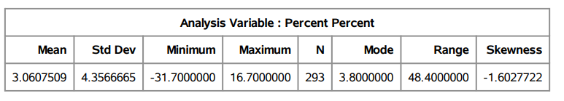
Data from MIS445 Home Page
Data from FED website

Slide 5
DATA FROM THE FED
ACTUAL DATA FROM 4/1/2020
Data pulled from the FED’s (2020) website, a simple scatter plot regression shows some interesting information.
The scatter plot has different lines to help identify trends. The solid green line is 0% ΔGDP growth , neither growing nor contracting. The solid blue line is a simple linear regression for best fit with a single degree of freedom. The dashed blue lines represent 2 Standard Deviations (2σ) from the mean.
Pointers have been added to the scatter plot to point out GDP measurements that fall outside of the mean 2σ (to the downside).

Slide 6
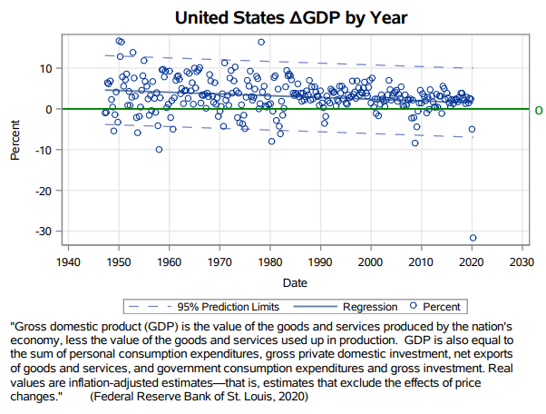

Slide 7
STATISTICAL SIGNIFICANCE
DO WE HAVE ENOUGH DATA TO REJECT THE NULL HYPOTHESYS?
N=293
Based on the data, the probability of obtaining data as extreme or more extreme than the measurement of the change in GDP of -31.7% is <0.0001%, orders of magnitude less likely than 95%/2σ significance level (α)
As the p-value of 0.001% is less than α we reject the null hypothesis ‘American GDP is not undergoing abnormal change’ in favor of the alternate hypothesis ‘American GDP is undergoing abnormal change.
As of the date of this publication, the author supports a theory that the drastic decline in United States GDP is correlated with the outbreak of COVID-19. Further analysis is needed.

Slide 8
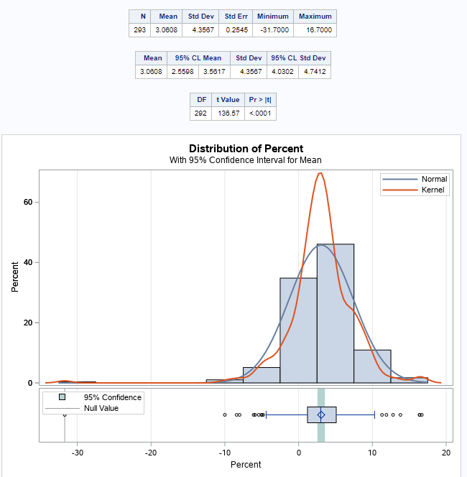

Slide 9
References
Federal Reserve Bank of St. Louis. (2020, August 27). Real Gross Domestic Product. Retrieved September 20, 2020, from https://fred.stlouisfed.org/graph/?g=tyLG
SAS. (2020, July 1). Creating Summary Statistics for a Table. Retrieved September 20, 2020, from https://documentation.sas.com/?docsetId=etlug
SAS. (2020, July 30). SCATTERPLOT Statement. Retrieved September 20, 2020, from https://documentation.sas.com/?docsetId=grstatgraph

